Slide 1

Product Knowledge Training Session PIBAS Products – Account Opening Part 3 – November 16, 2012
Presented By Muhammad Asim Senior Support Analyst

Slide 2
Contents
Customer Account Opening Part 3
Cheque Book Issuance
Cheque Book Type Maintenance
Cheque Book Stock Maintenance
Stop Cheque Maintenance
Hold / Lien Maintenance
Cheque Maintenance Report
Cheque Book Detail Report
Cheque Book / Hold / Lien Supervision

Slide 3
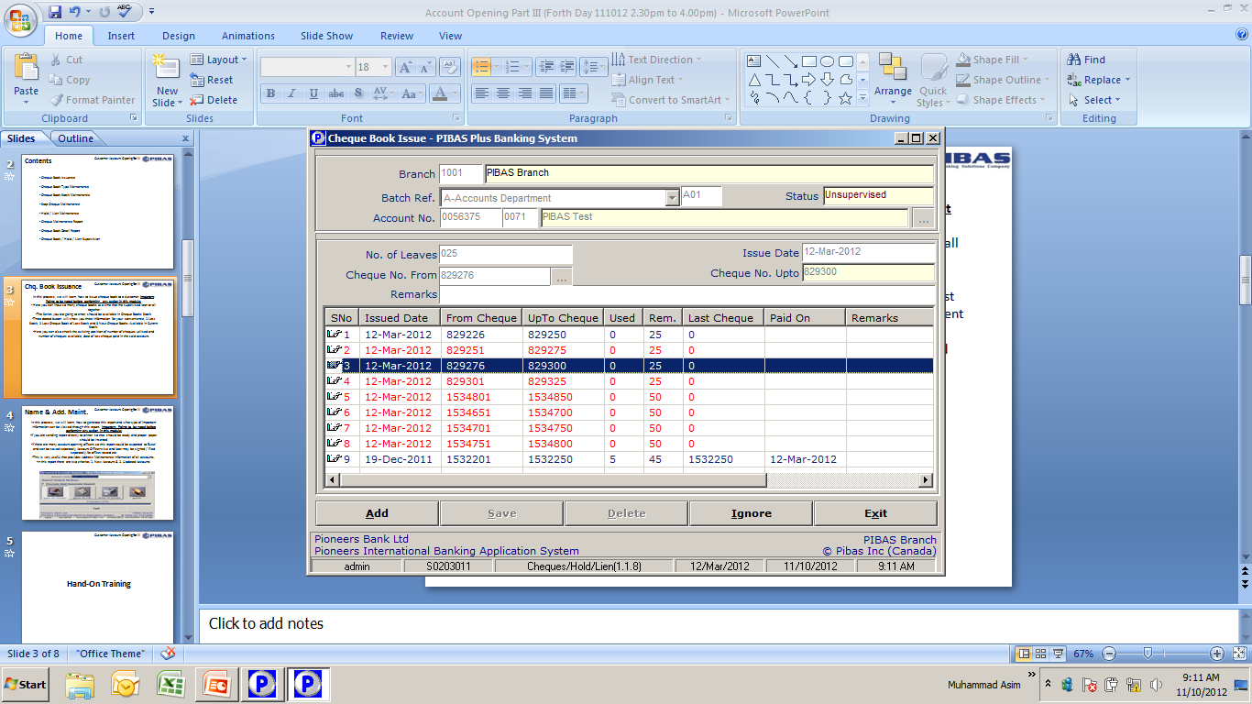
Chq. Book Issuance
Customer Account Opening Part 3
In this process, we will learn, how to issue cheque book to a customer. Important Points to be noted before performing any action in this module:
Here you can input so many cheque books at a time that me supervised later or all together
The Series you are going to enter, should be available in Cheque Books Stock
Three dotted button will show you three information for your convenience, 1 Last Stock, 2 Last Cheque Book of Last Stock and 3 Next Cheque Books Available in Current Stock.
Here you can also check the existing position of number of cheques utilized and number of cheques available, date of last cheque paid in the said account.

Slide 4
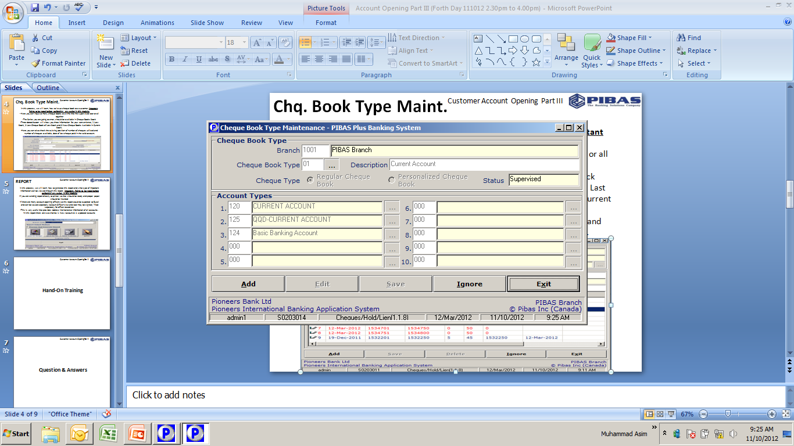
Chq. Book Type Maint.
Customer Account Opening Part 3
In this process, we will learn, how to create or view any Cheque Book Type. Important Points to be noted before performing any action in this module:
Here you can define more than one account types for a particular cheque book type
This option requires supervision and same user cannot supervise.
After defining new cheque book type, Stock Input is necessary otherwise, cheque numbers will not be appeared while issuance of cheque books to customer.
Once you have fed / created any cheque book type so it can never be edited, as you can see that Edit Button is not enable although it is admin ID.
Description of cheque book type should be meaningful so that any user can input the correct cheque book in correct account.

Slide 5
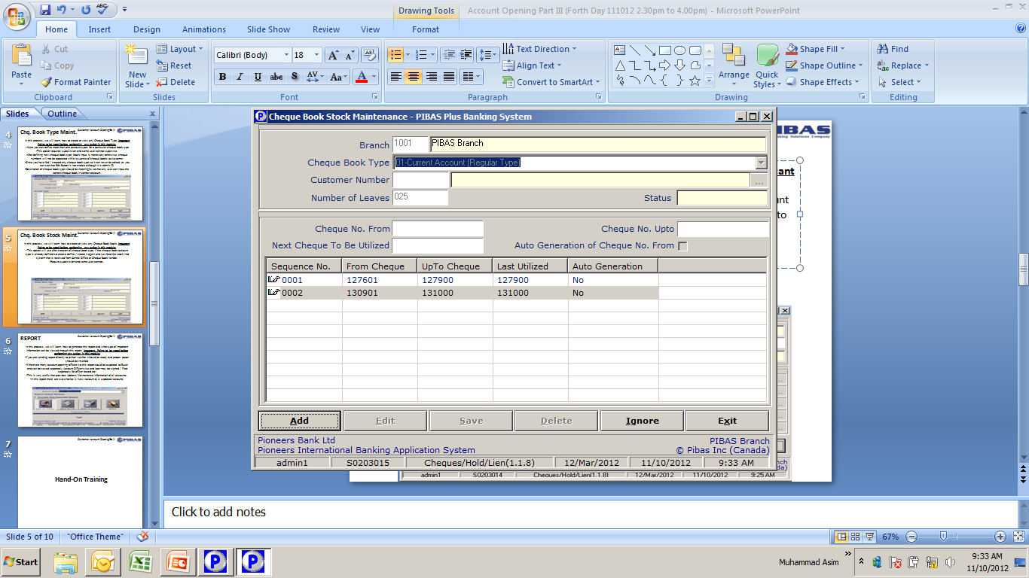
Chq. Book Stock Maint.
Customer Account Opening Part 3
In this process, we will learn, how to create or view any Cheque Book Stock. Important Points to be noted before performing any action in this module:
This option will use after creation of cheque book type, if the cheque book account type is already defined so please define / create it again and just feed the stock into system that is received from Central Office or Cheque Book Vendor.
Require supervision and same user cannot..
Here you can also note that history of previous stocks
Here you will not input ‘next cheque to be utilized’ option, it will automatically appear upon input of correct ‘cheque no. from’ and ‘cheque no. upto.’

Slide 6
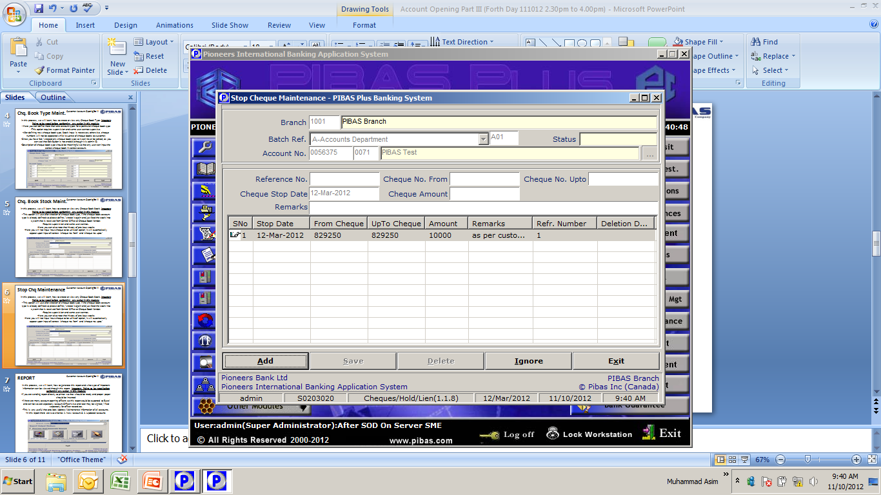
Stop Chq Mark / Rem
Customer Account Opening Part 3
In this process, we will learn, how to stop / remove stop on a cheque or series of cheques as per customer request or as per any decision taken by Government etc. Important Points to be noted before performing any action in this module:
Here you can stop many cheques at a time
Here you can also view any stop cheque (s) previously stopped by the customer etc.
Any stopped cheque cannot be input into any module of system i.e. Remittance Module or Transaction Module etc.
Upon release of stop, then the same cheque can be utilized.
Charges if any as per Schedule of Charges of the bank will be recovered upon Stop or Release of Stop.

Slide 7
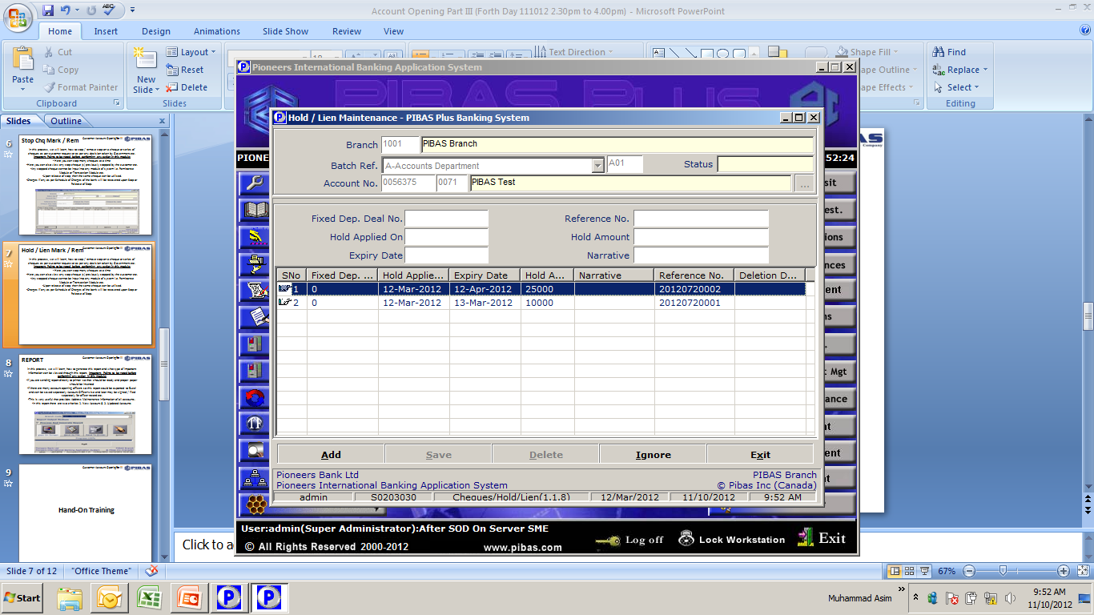
Hold / Lien Mark / Rem
Customer Account Opening Part 3
In this process, we will learn, how to mark / remove hold / lien from an account and also view the existing hold / liens. Important Points to be noted before performing any action in this module:
Please take extra care while inputting expiry of hold amount, if you input incorrect date here so, system will automatically remove this hold on that incorrect date.
Please always input correct narration / reason for hold so that one can easily note the reason
Hold can be applied as per Customer Request, Bank’s Requirement or any other directive given by Government particularly regarding freezing of accounts / assets circulars, issued by regulatory bodies.
Any hold can be removed just clicking the delete button.

Slide 8
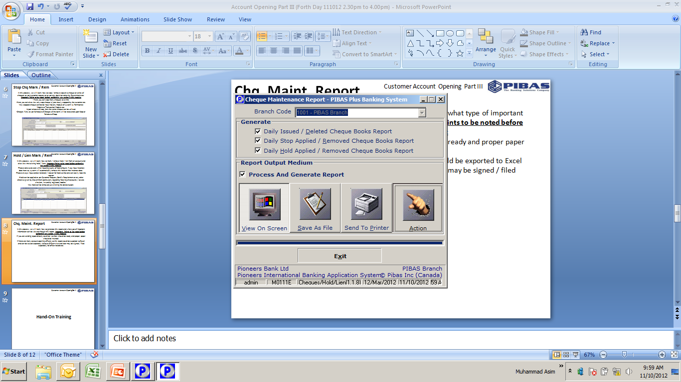
Chq. Maint. Report
Customer Account Opening Part 3
In this process, we will learn, how to generate this report and what type of important information can be viewed through this report. Important Points to be noted before performing any action in this module:
If you are sending report directly to printer so that should be ready and proper paper should be inserted
If there are many account opening officers so this report could be exported to Excel and can be saved separately Account Officer-wise and later may be signed / filed separately for officer record etc.
Here you can generate following three types of reports in one interface.

Slide 9
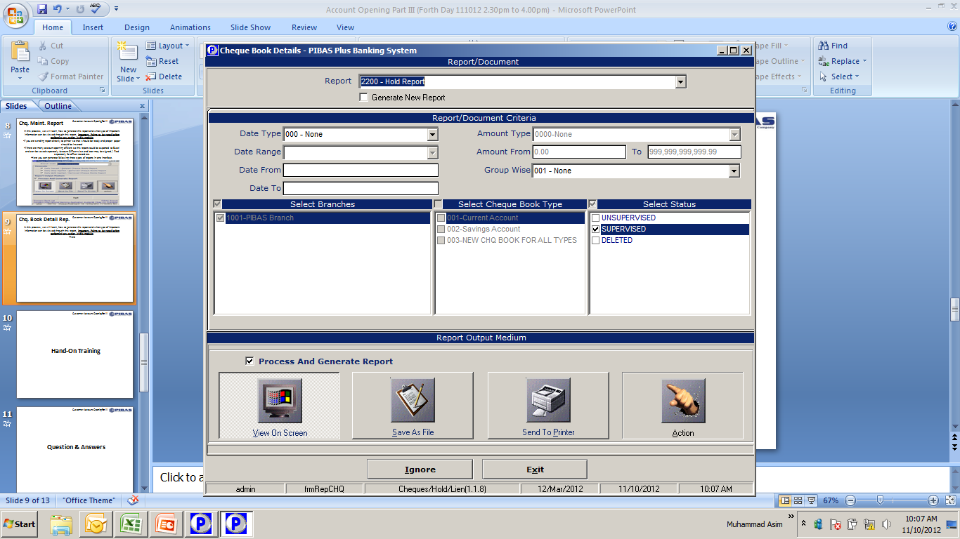
Chq. Book Detail Rep.
Customer Account Opening Part 3
In this process, we will learn, how to generate this report and what type of important information can be viewed through this report. Important Points to be noted before performing any action in this module:
This report name shows that it relates to cheque only but it provides, Cheque Book Report, Cheque Book Status Report, Stop Cheque Report, Hold Report, Lien Report, Cheque Book Type Report and Cheque Book Stock Report.
In addition to this, Date Type, Date Range, Account Type and Account Number options are also available

Slide 10
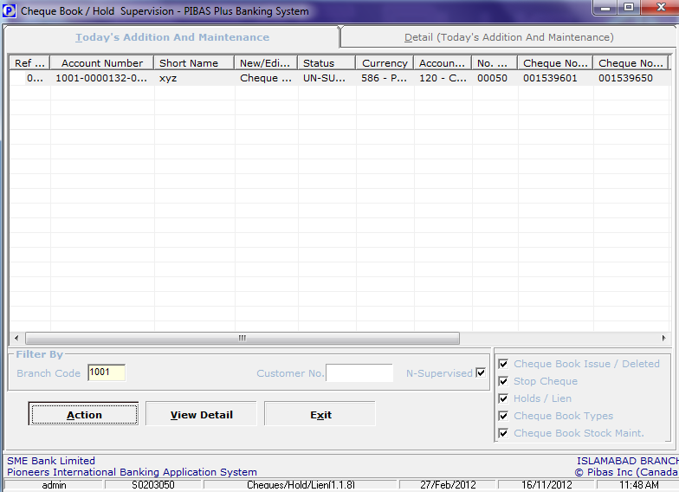
Chq Bk / Hold / Lien Supervision
Customer Account Opening Part 3
Important Points to be noted before performing any action in this module:
This option is used to supervise all related transactions

Slide 11
Customer Account Opening Part 3
Thanks for your active participation

